Slide 1









Slide 2


The Trumpington
Bed Burial
Curriculum Link: Anglo Saxons Year 5

Slide 3
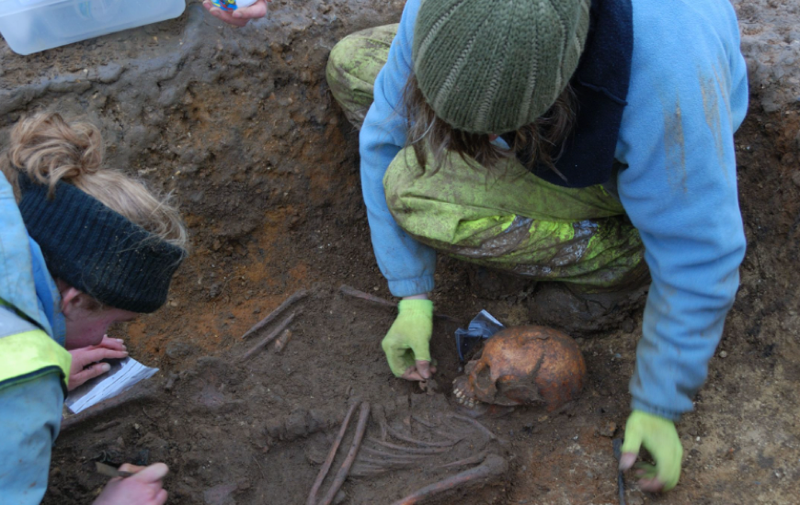
What job do archaeologists and historians do?
Both archaeologists and historians use sources and evidence to learn about the past.

Slide 4
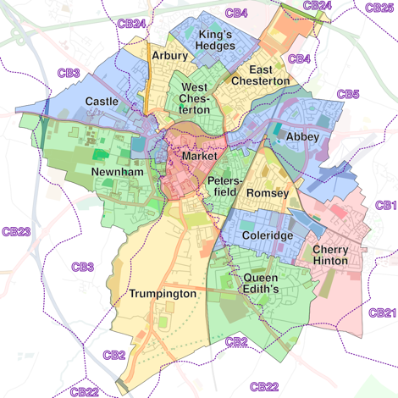
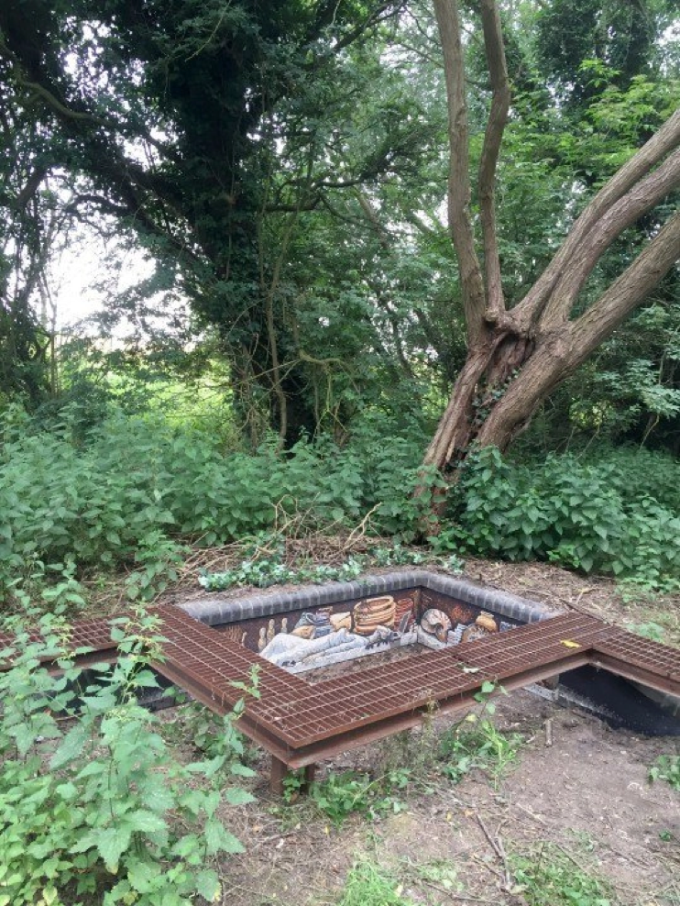
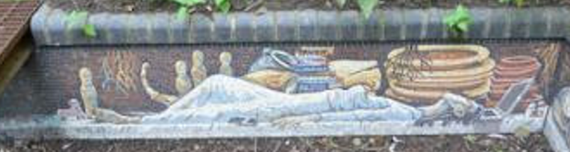
Have a look at this strange place. It can be found hidden in the woods in Trumpington Meadows in Cambridge.
What might it be?
What makes you think this?

Slide 5

In 2011, at Trumpington Meadows, the Anglo-Saxon grave of a young woman was excavated.
She lived 1,400 years ago.
Everything we know about the Trumpington girl must be gleaned from the single snapshot of her grave site.
No written sources identify her.
Today, you are going to be the archaeologists and historians and using the artefacts and evidence discovered in the grave, you will piece together the life of the person buried…

Slide 6
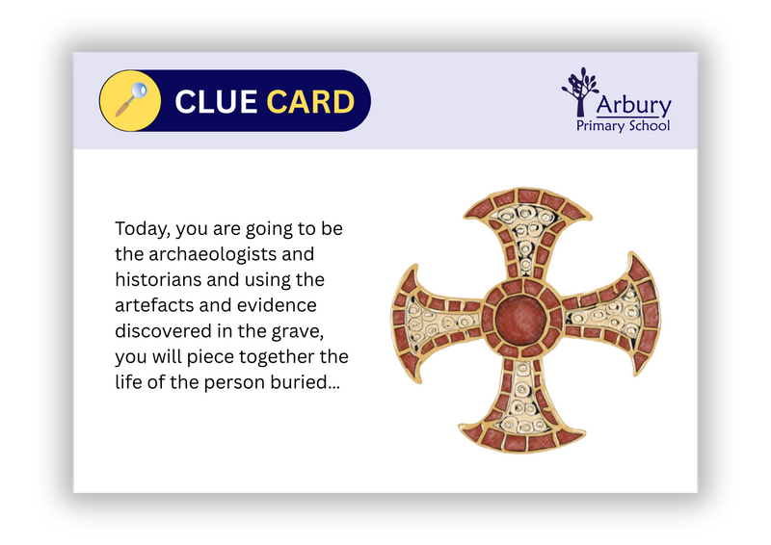
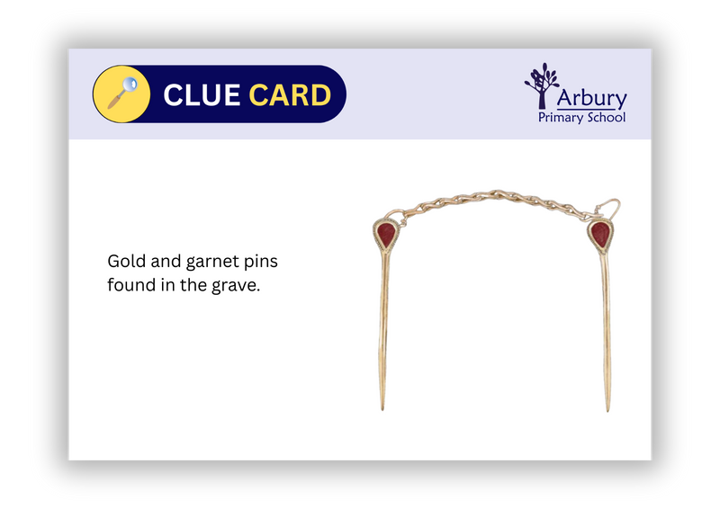
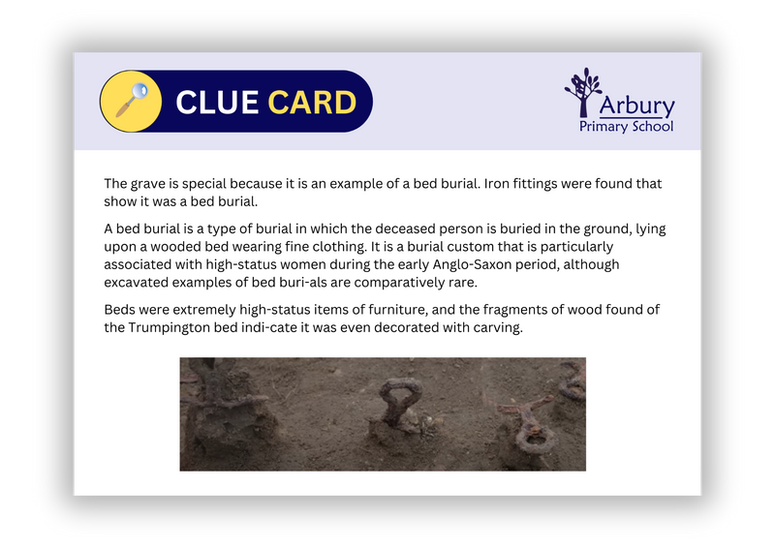
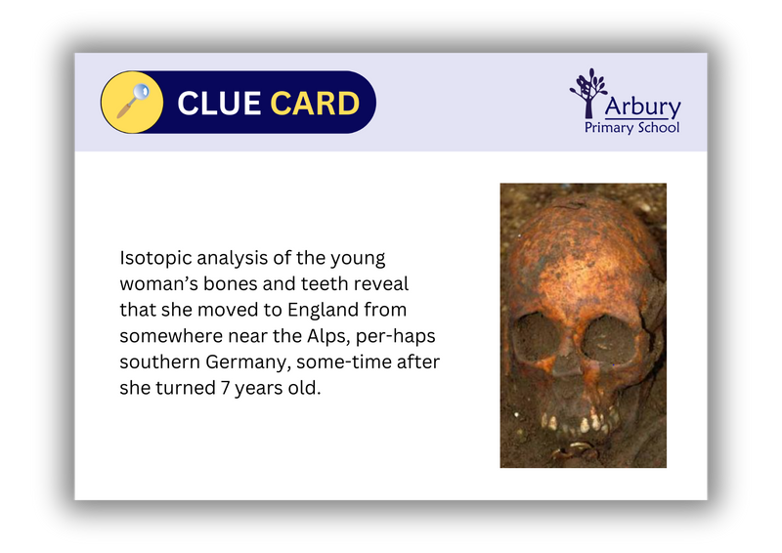
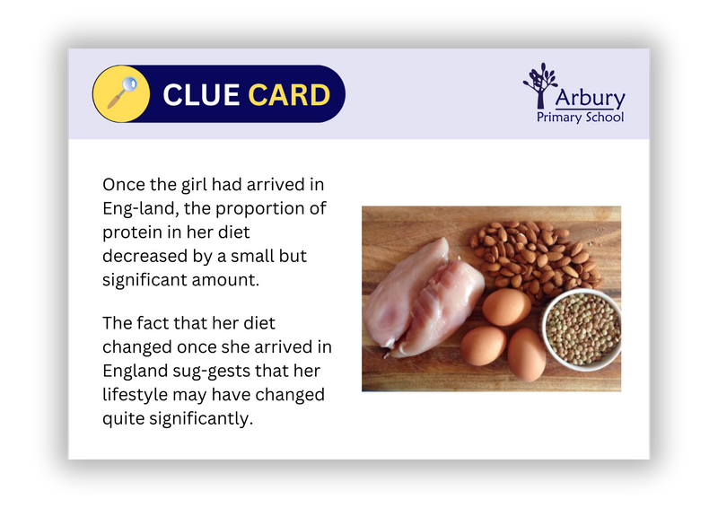
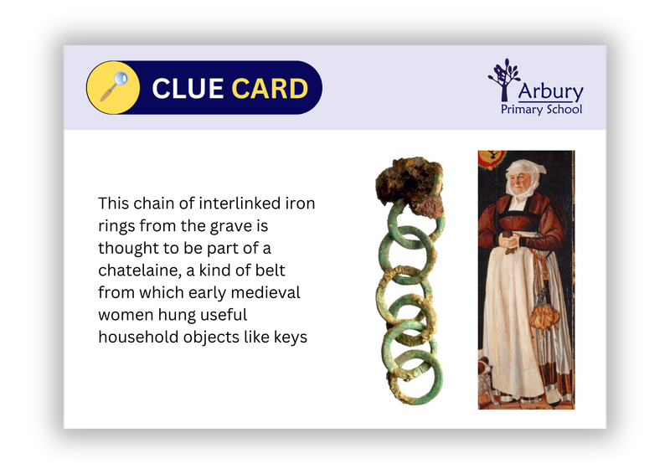
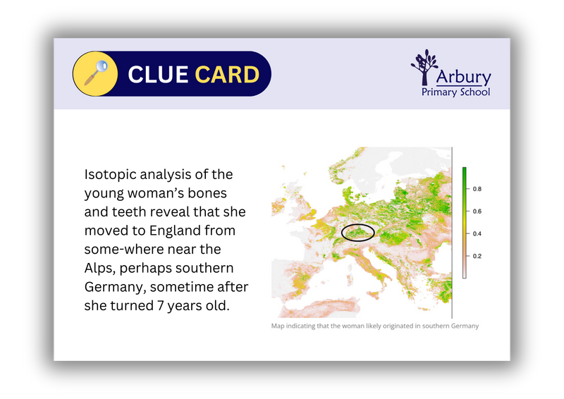
With your group, look at the evidence you have been given (Clue cards).
What can you find out about the person buried in this grave?
In your group be prepared to share your thoughts…

Slide 7
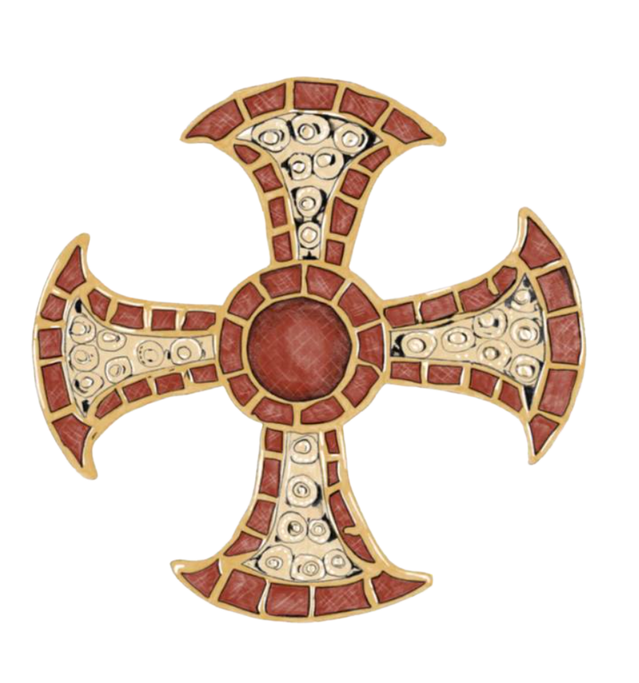
Source 1
A gold and garnet cross was found in the grave.
The best known example of such a cross was found in the coffin of St Cuthbert.
What might this artefact tell us about the person buried?

Slide 8
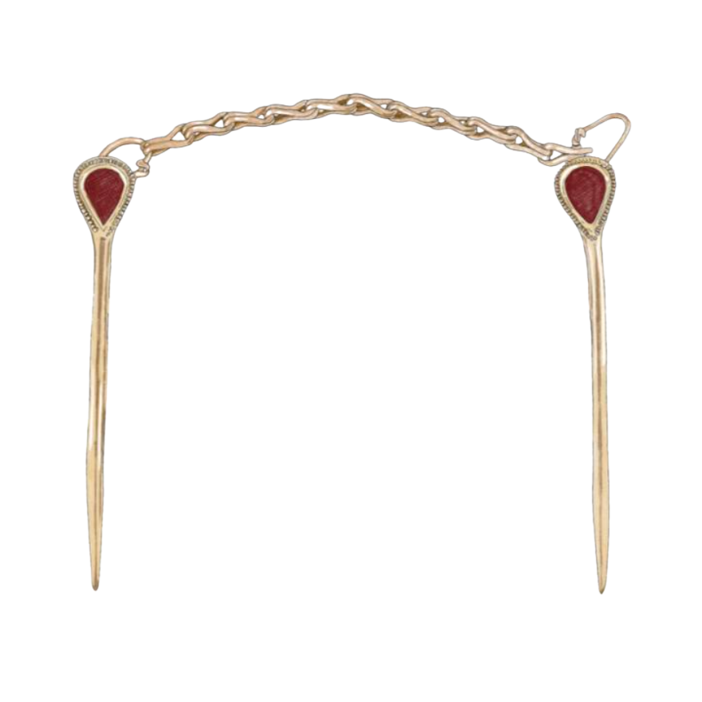
Source 2
Gold and garnet pins found in the grave.

Slide 9
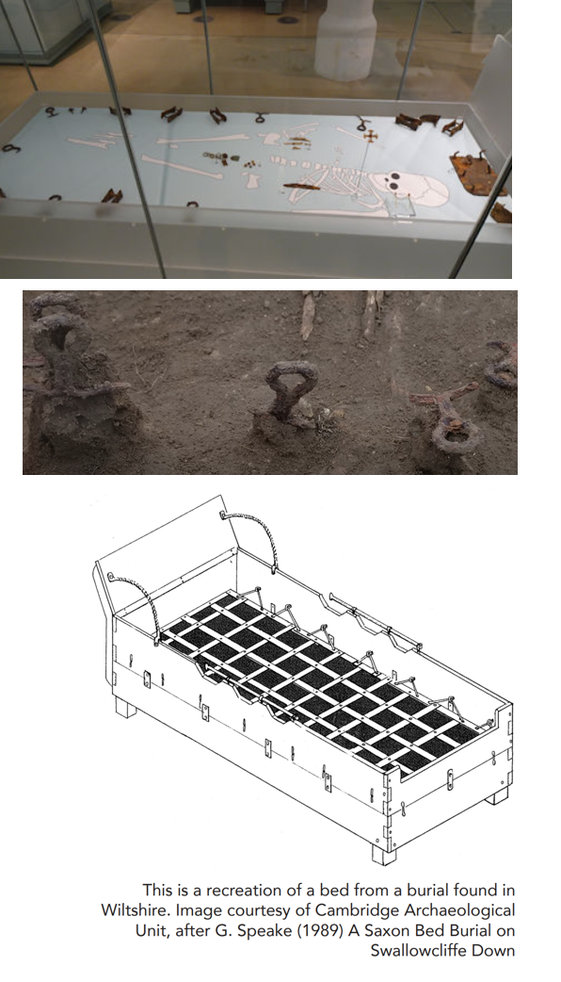
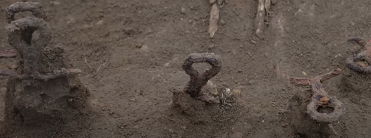
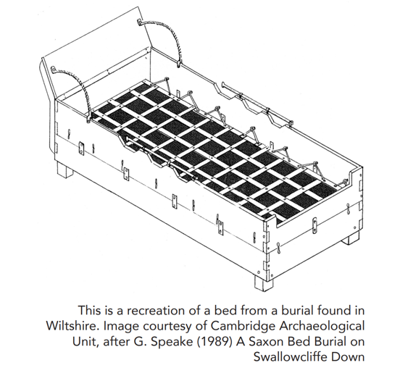
Source 3
The grave is special because it is an example of a bed burial. Iron fittings were found that show it was a bed burial.

Slide 10
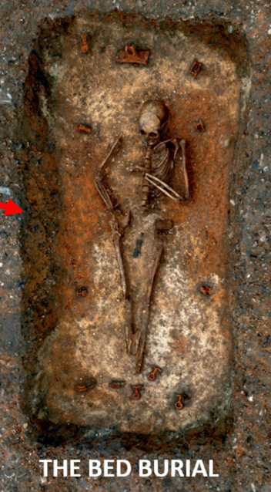
Source 3
A bed burial is a type of burial in which the deceased person is buried in the ground, lying upon a wooded bed wearing fine clothing. It is a burial custom that is particularly associated with high-status women during the early Anglo-Saxon period, although excavated examples of bed burials are comparatively rare. Beds were extremely high-status items of furniture, and the fragments of wood found of the Trumpington bed indicate it was even decorated with carving.

Slide 11
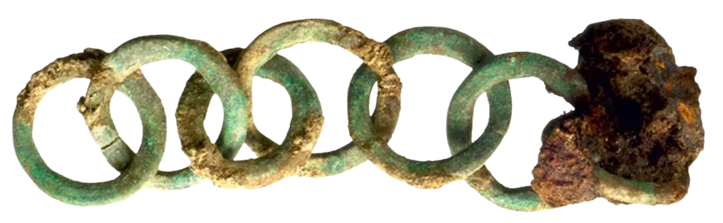
Source 4
This chain of interlinked iron rings from the grave is thought to be part of a chatelaine, a kind of belt from which early medieval women hung useful household objects like keys and knives.

Slide 12
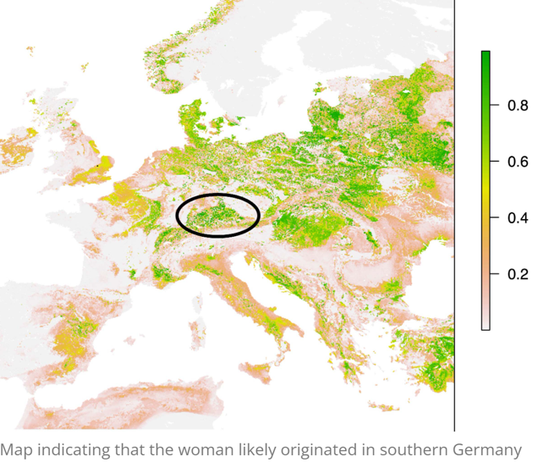
Source 5
Isotopic analysis of the young woman’s bones and teeth reveal that she moved to England from somewhere near the Alps, perhaps southern Germany, sometime after she turned 7 years old.

Slide 13
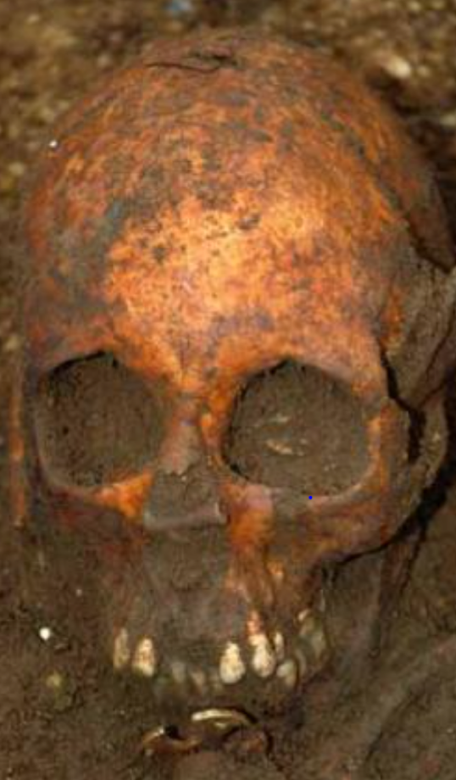
Source 6
Previous analysis indicated that the young woman had suffered from illness but her cause of death remains unknown.
A combination of dental and bone analysis revealed the likely age of the person when they died was 14-18 years old.

Slide 14
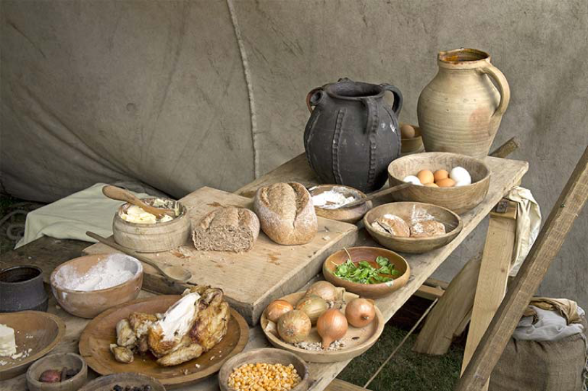
Source 7
Once the girl had arrived in England, the proportion of protein in her diet decreased by a small but significant amount.
The fact that her diet changed once she arrived in England suggests that her lifestyle may have changed quite significantly.

Slide 15
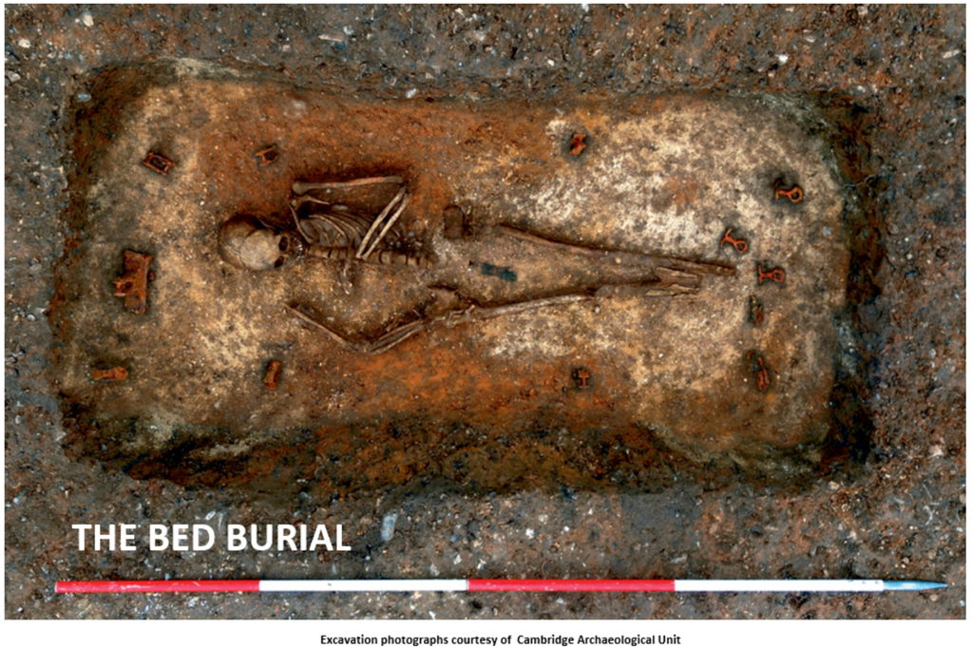
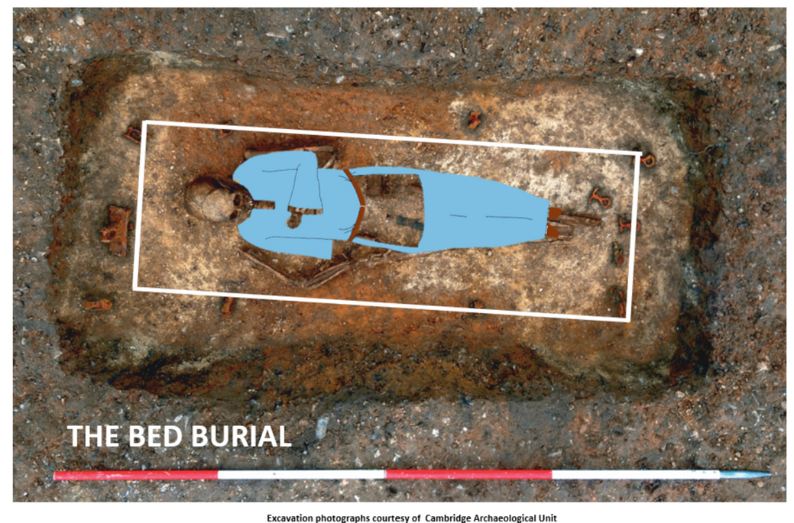
This is what the bed burial looked like when it was discovered by archaeologists…

Slide 16
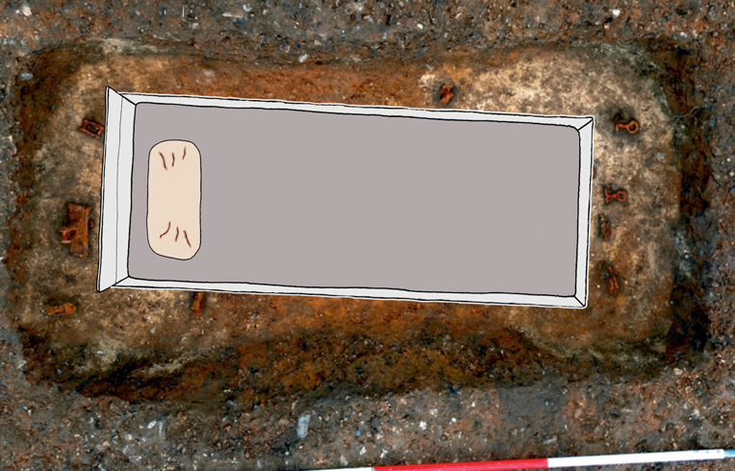
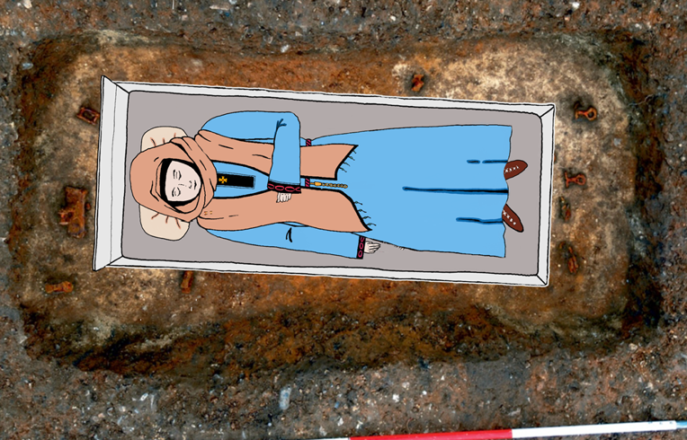
What the burial may have looked like at the time:

Slide 17
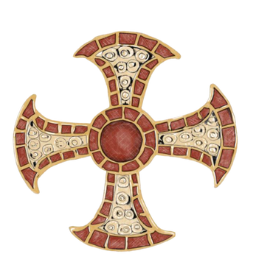
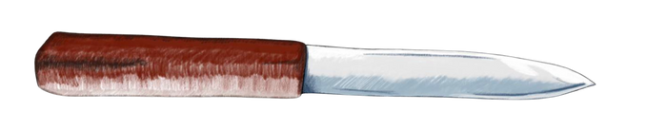
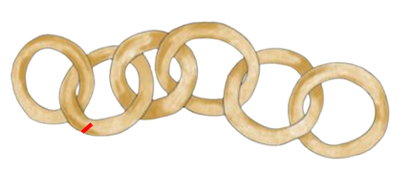
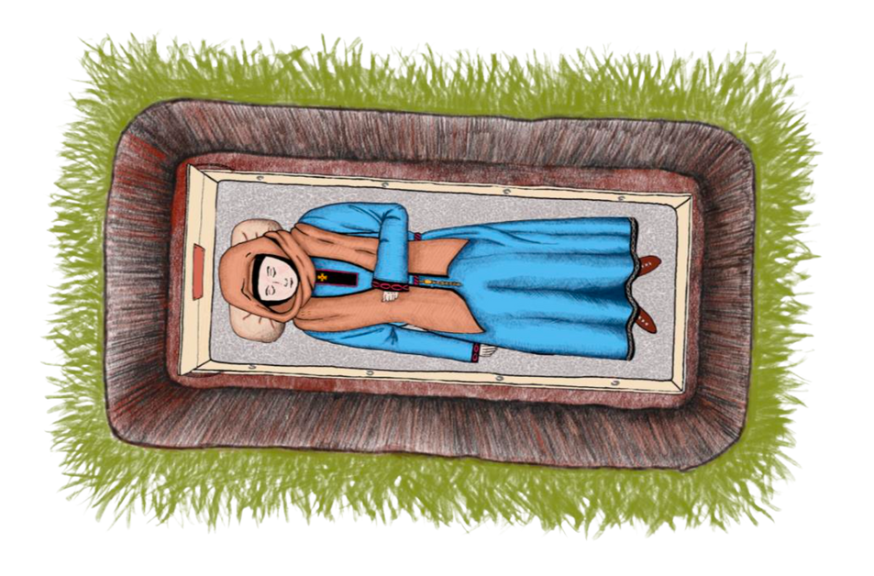
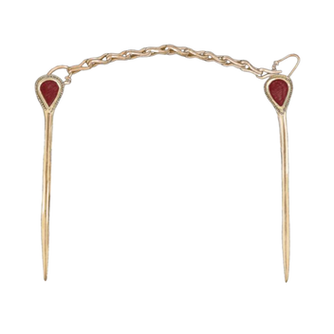
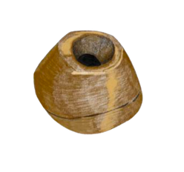
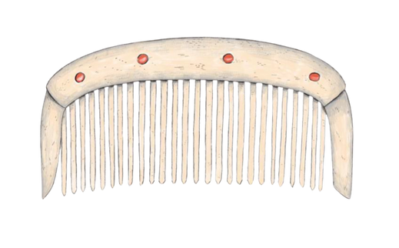
Early Medieval Bed Burial, Trumpington
Source 8
The girl was also found with some other grave goods. These included a bone comb and small glass beads that probably formed part of a beaded edge to a veil as well as an iron knife with a horn handle and leather sheaf.

Slide 18
What do these pieces of evidence tell you about the person who was buried?
Task:
Write a short paragraph about the evidence, making inferences about the person buried.
Example:
I think the girl buried must have been Christian because she was found with a cross in her grave. I also think she may have been wealthy because the cross was made from gold and garnets. Additionally, a gold and garnet pin was also found in her grave which shows she must have been rich or important.

Slide 19

Watch the film…can you find out anything more from the archaeologist that excavated the grave?

Slide 20
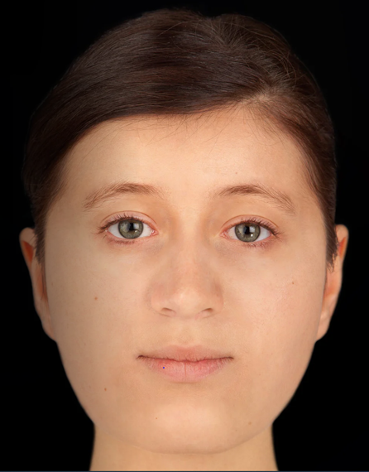
Forensic artist Hew Morrison created the likeness of the Trumpington woman using measurements of the woman’s skull and tissue depth data for Caucasian females.
We can’t be sure of the girl’s hair or eye colour.
Hew Morrison said: “It was interesting to see her face developing. Her left eye was slightly lower, about half a centimetre, than her right eye. This would have been quite noticeable in life.”
How does it make you feel seeing what the girl may have looked like?

Slide 21
Look at the statements below. Do you think they are facts/myths or things we can’t be sure of? Where would you place them on the scale? Why?
The Trumpington girl was a Christian
Fact
Myth
The Trumpington girl was an important person
Fact
Myth
The Trumpington girl was born in Germany
Fact
Myth

