Slide 1

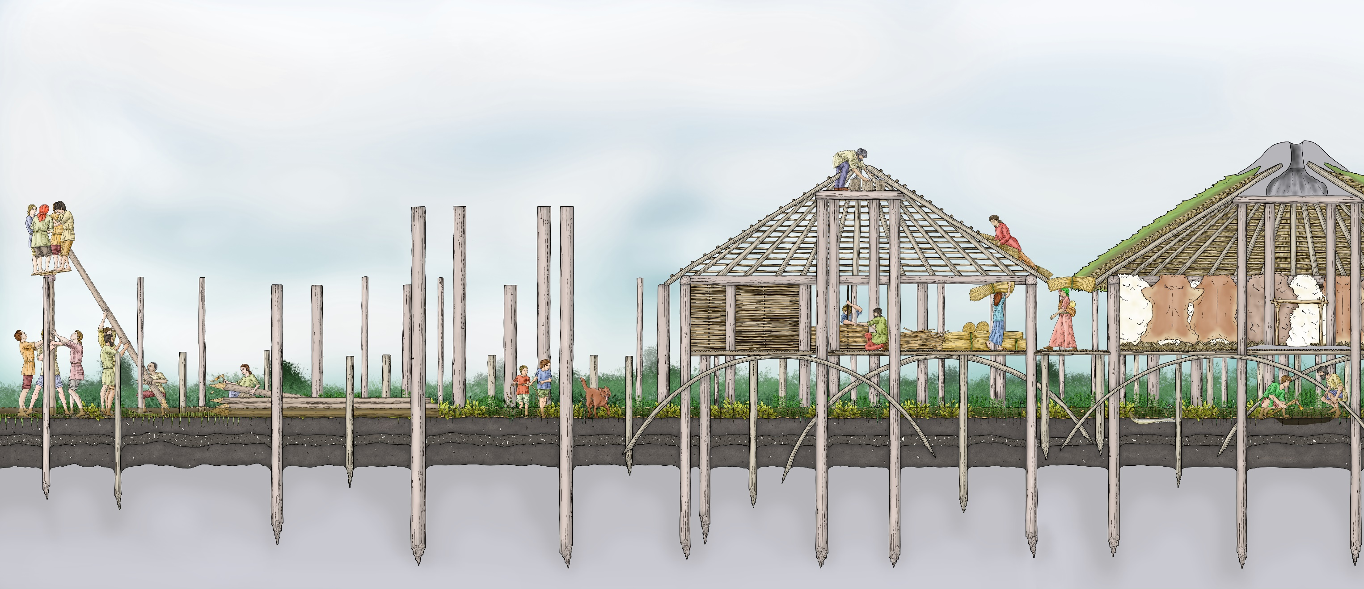
Building Must Farm
Building Must Farm

Slide 2
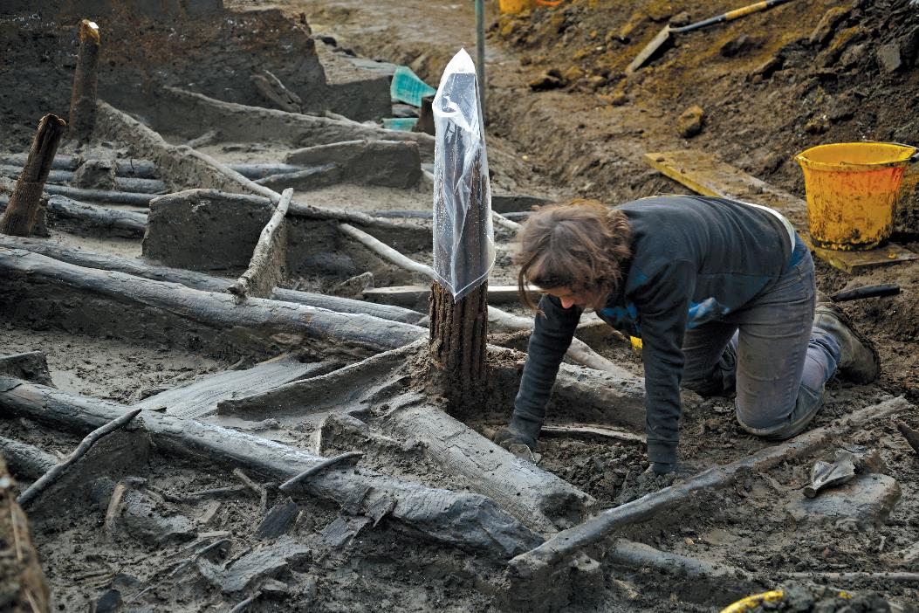
What materials were used to build Must Farm?
Archaeologists found over 18,000 pieces of wood that were part of the houses.
As everything was so well preserved at Must Farm, special archaeologists that study wood were able to work out the types of trees that had been used to build it.
At least 11 types of wood were used to build Must Farm

Slide 3
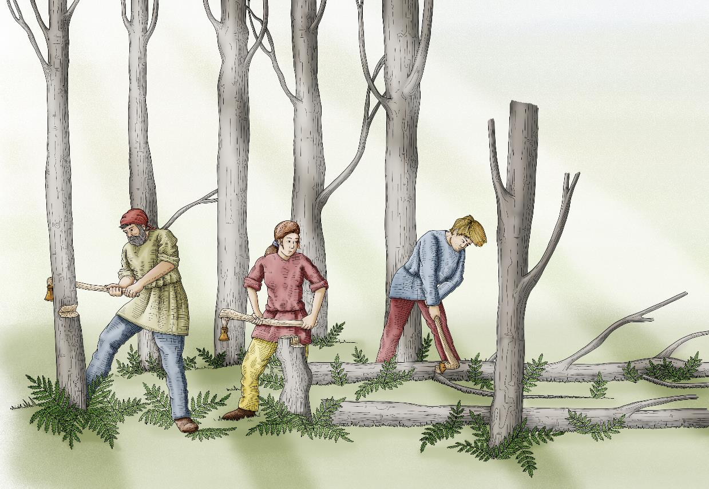
Where did the materials to build Must Farm come from?
Some of the trees, like oak and ash, grow in drier ground so the builders would have had to travel further away to find them and cut them down.
After they had chopped the trees down people would have dragged them to the nearest river. The builders could then have floated the logs on the water making it easier to move them to where they needed to be.

Slide 4
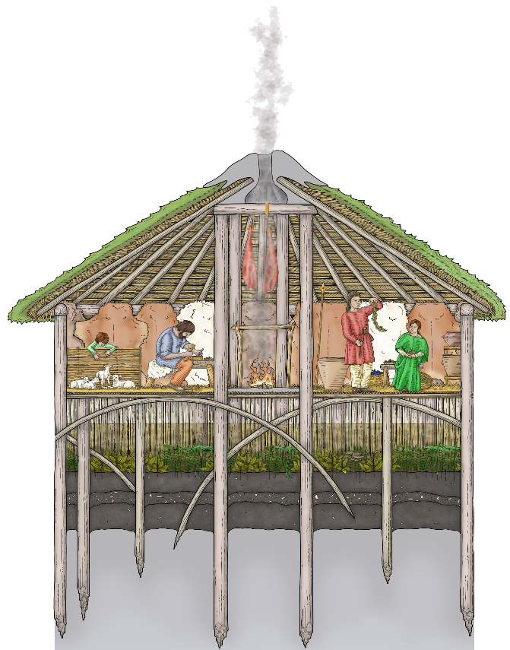
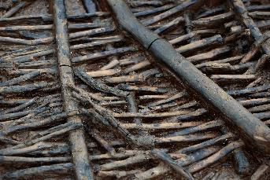
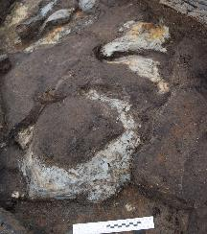
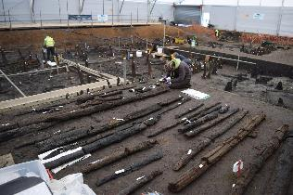
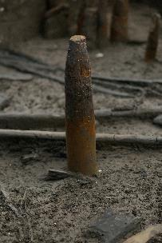
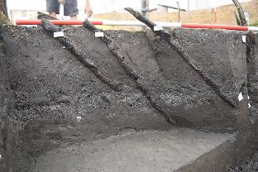
What would a Must Farm house have looked like?
Houses were built from two circles of posts which people then added walls, floors and roofs to.
The buildings at Must Farm are circular in shape and are called roundhouses.
Archaeologists find lots of roundhouses but the ones at Must Farm are special because they were built on stilts over a river.
Clay Area
Wattle
#1d4289
Rafters
Arched Supports
Piles

Slide 5
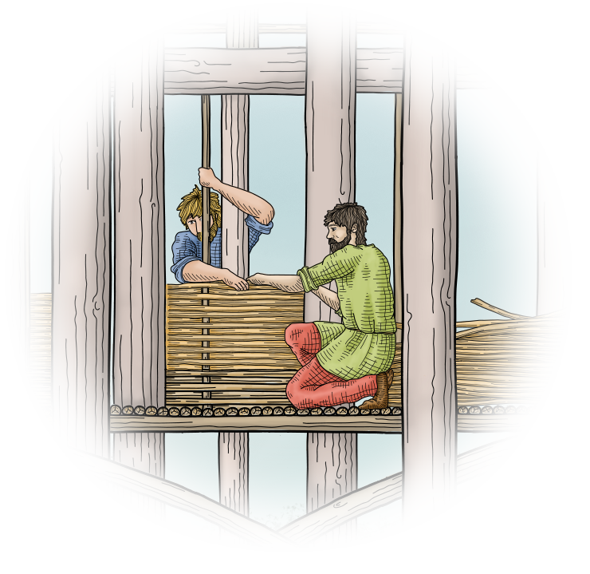
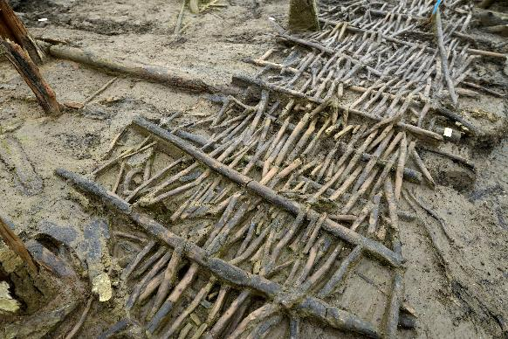
Making Must Farm’s walls and floors
The floors and walkways over the river at Must Farm would have been made by weaving together smaller pieces of wood to make wattle panels. These would probably have been springy to walk around on.
Wattle
Walkway
Constructing a wattle wall
The walls would also have been made from wattle. Archaeologists think that the people living at Must Farm might have hung animal skins or textiles on the inside of the walls to help to keep them warm and stop wind getting inside.

Slide 6
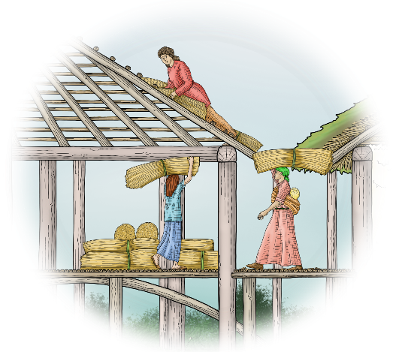
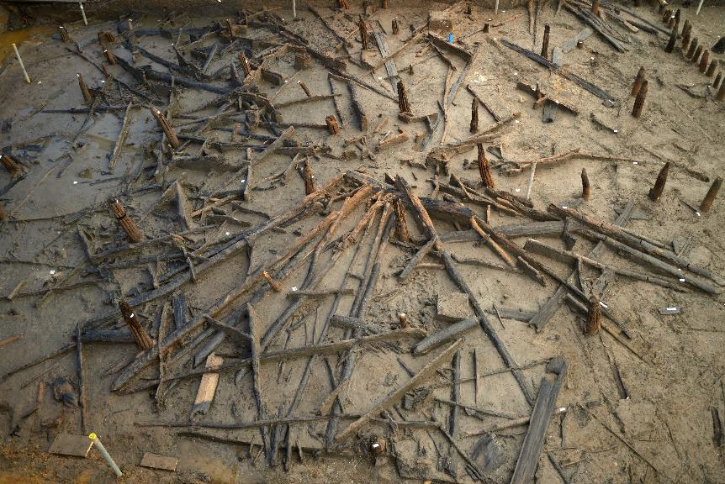
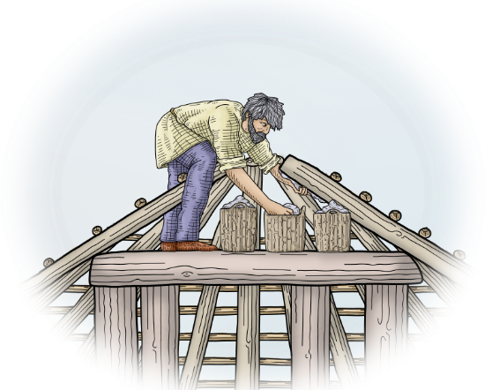
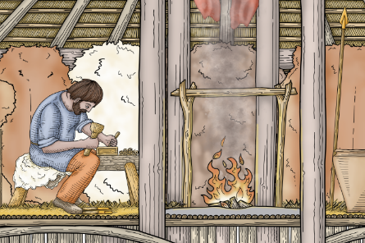
Roofs and hearths at Must Farm
Thatching the roof
Each of the houses had a fire inside, called a hearth, that would have been used for cooking and to provide warmth for the animals and people living there.
Clay was also added around the top of the roof which could have been used to help release smoke and keep the rain out.
The roundhouses would have had roofs made from a bottom layer of straw and a top layer of turf to help make the buildings waterproof.
Hearth
Clay being applied

Slide 7
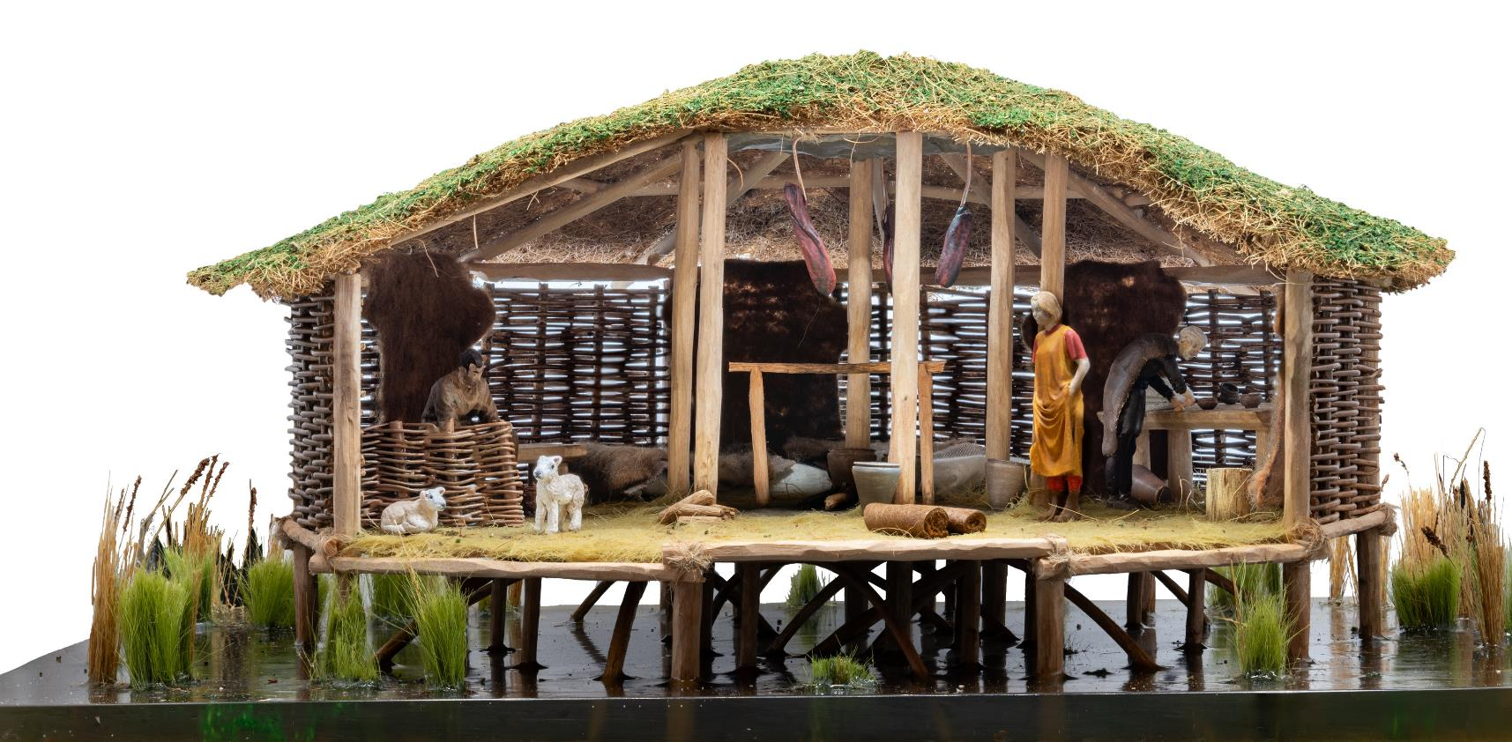
How was Must Farm built?
At Must Farm the big wooden posts that raised the houses out of the water are called piles. There are very important as they held up the buildings and supported the roofs.
The piles were made from oak and ash trees that were chosen because they were straight and already close to the right size.

Slide 8
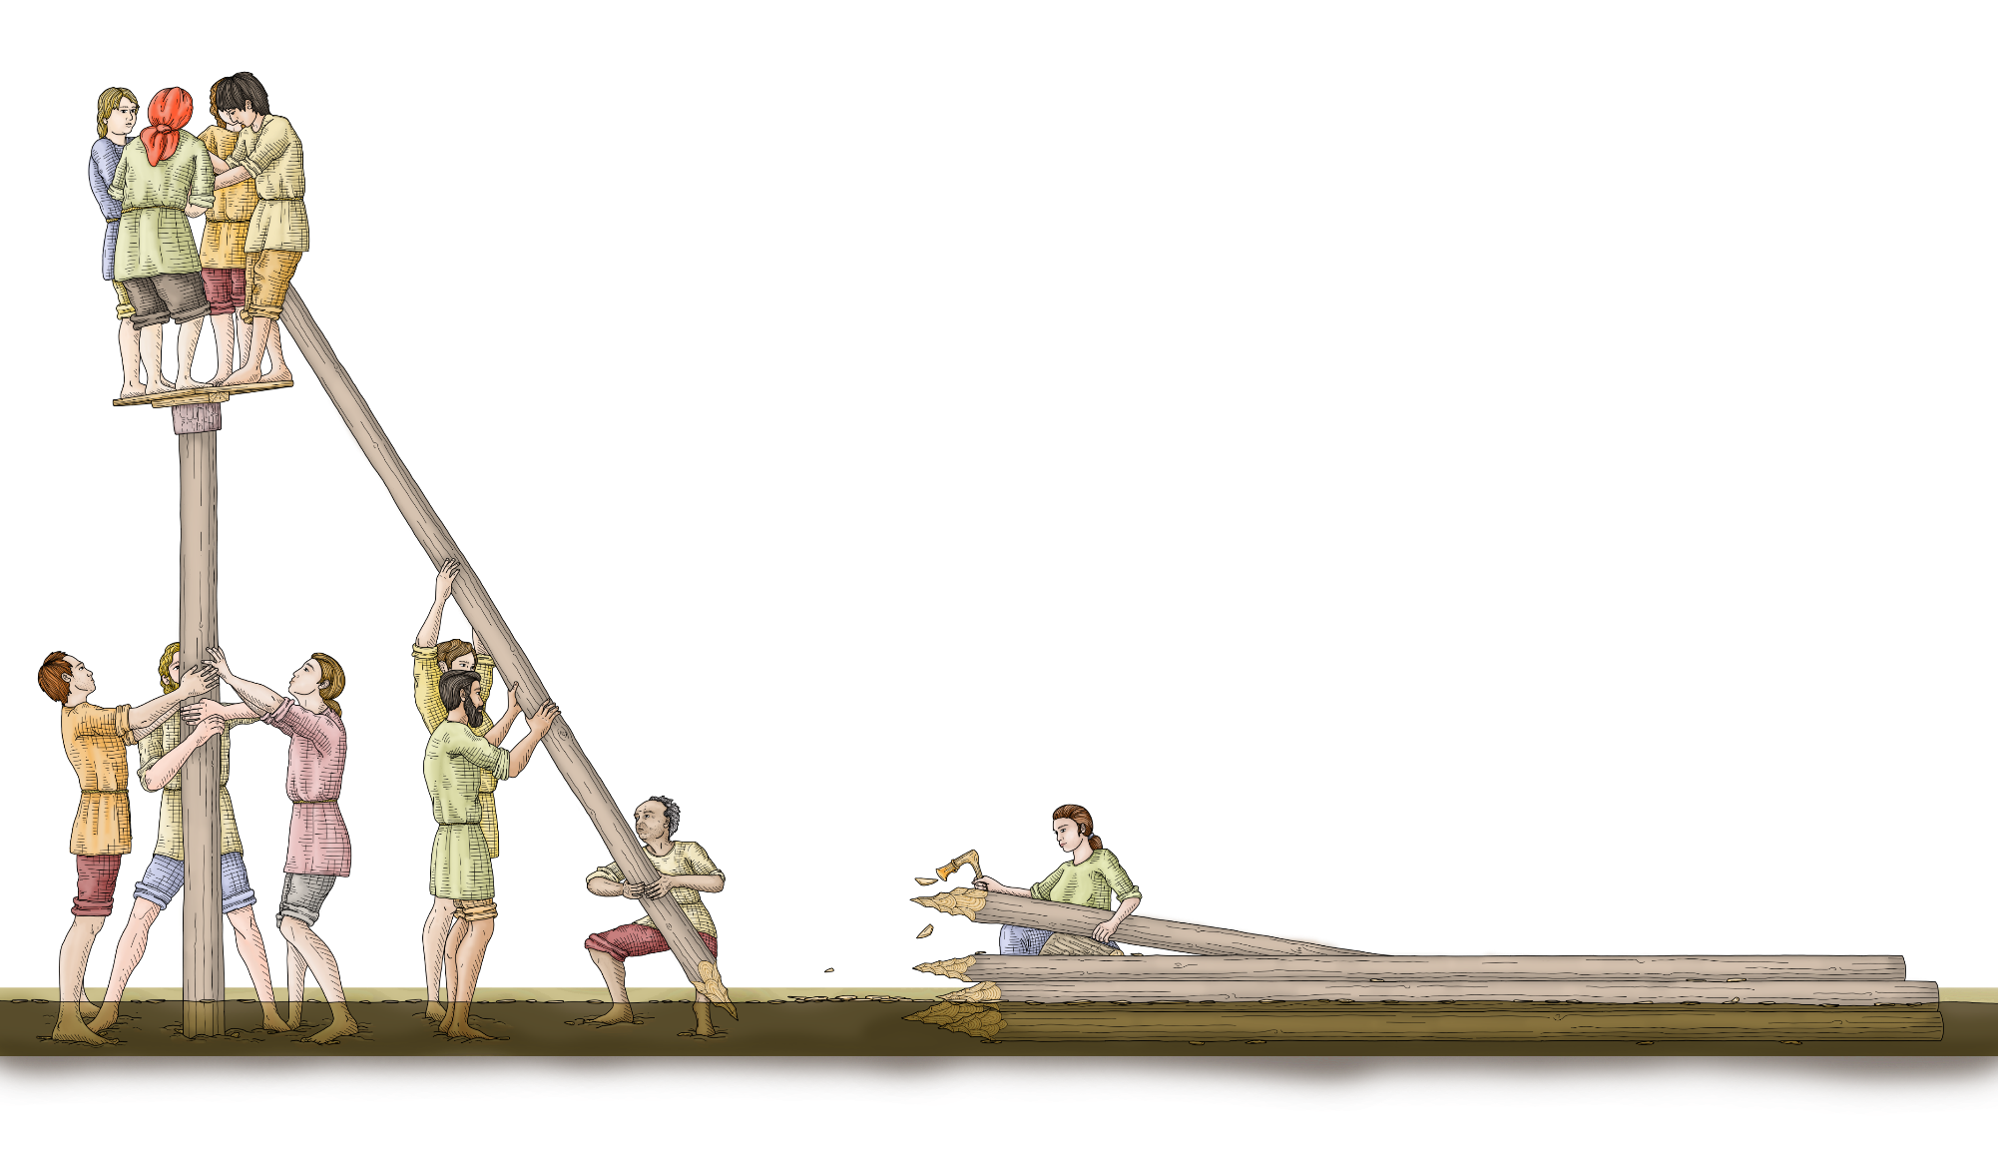
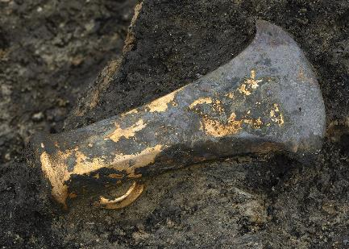
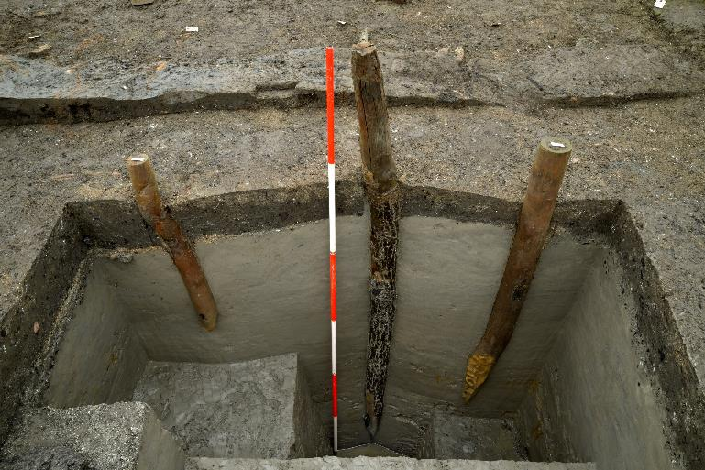
Piles (stilts) at Must Farm
The trees would then be moved to where the village was being built, probably by floating them down a river. Once they got there, people would have used axes to chop them into shape and create sharp points on their tips.
Axehead found
in situ
Piles pushing into the mud
A group of people would then have pushed the piles into the firm mud at the bottom of the river to hold it in place.

Slide 9
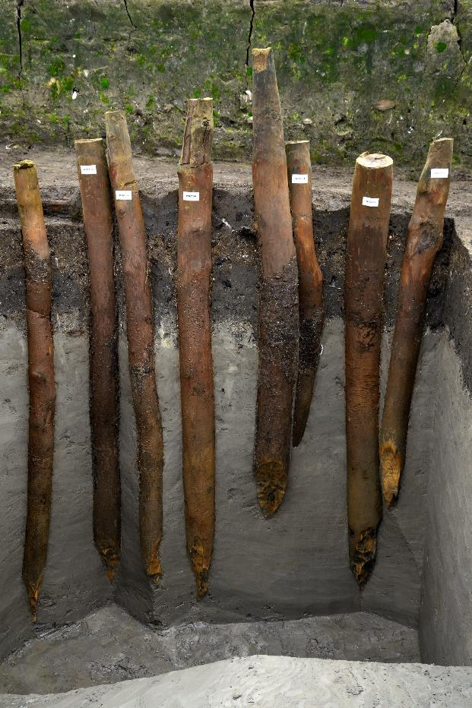
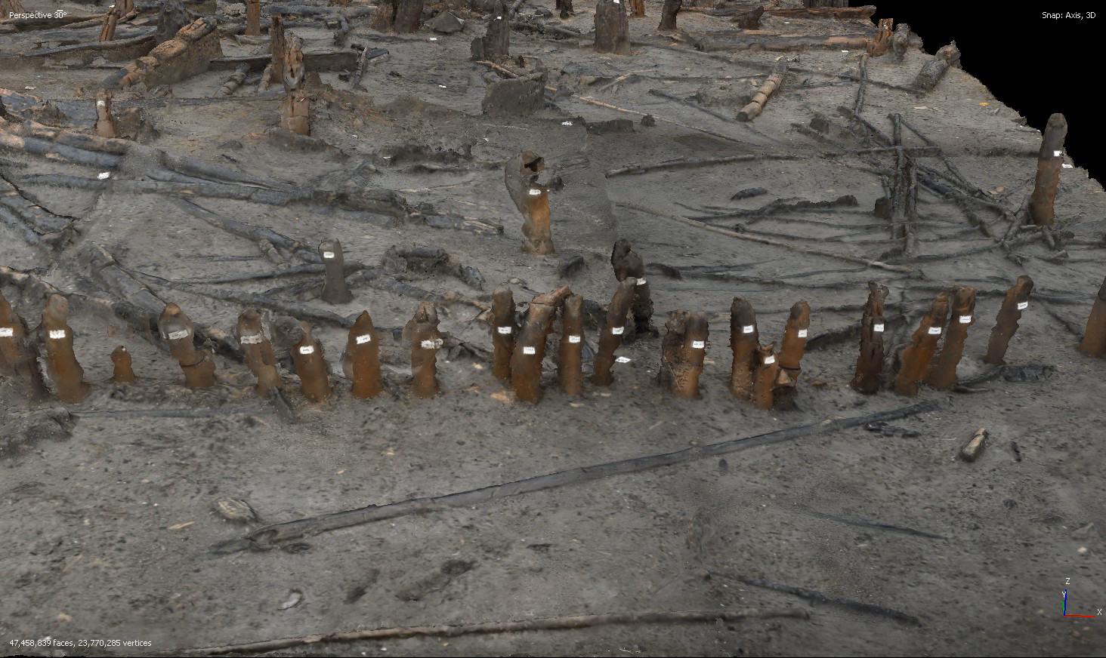
Must Farm’s palisade
Around the outside of the houses a large fence, called a palisade, was built by pushing more piles into the ground very close together. This created a wall of wooden posts and could have been made to help protect the people living at the village.

Slide 10
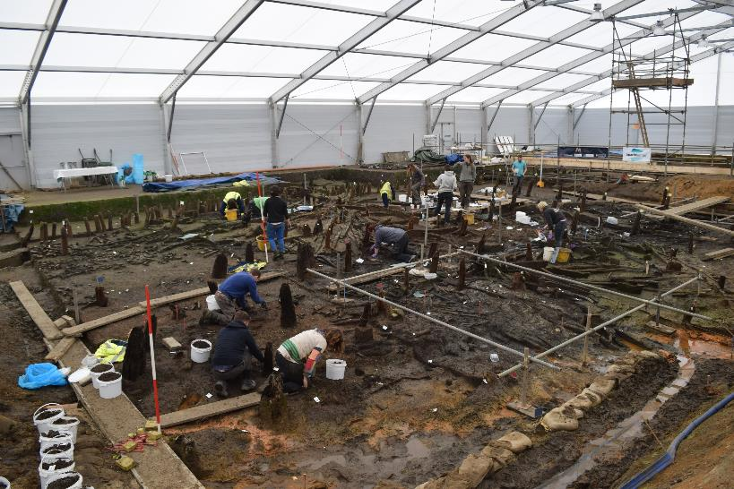
When was Must Farm built?
Archaeologists know from scientific tests, like radiocarbon dating, that the village at Must Farm was built around 850BC, a time called the Late Bronze Age.
Very special conditions at the site, that preserved lots of information, tell us that people started to build the village in late summer. At this hotter and drier time of the year, there was less water in the river that would have made it easier to move around and build the houses.
MUST FARM 850BC
2200BC
800BC
43AD
410AD
1066AD
NEOLITHIC
BRONZE AGE
IRON AGE
ROMANS
ANGLO-SAXONS & VIKINGS

Slide 11
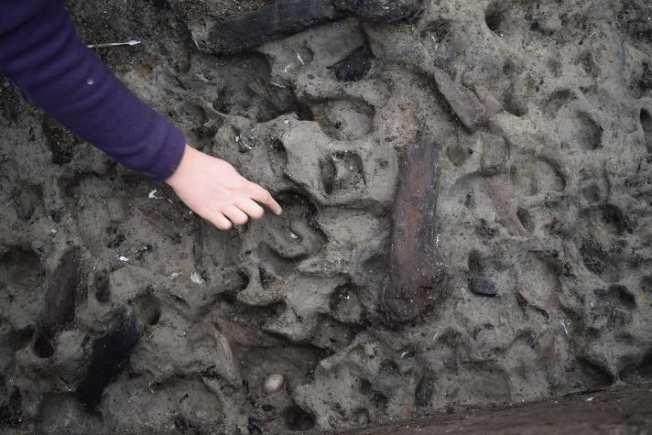
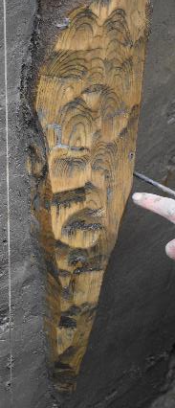
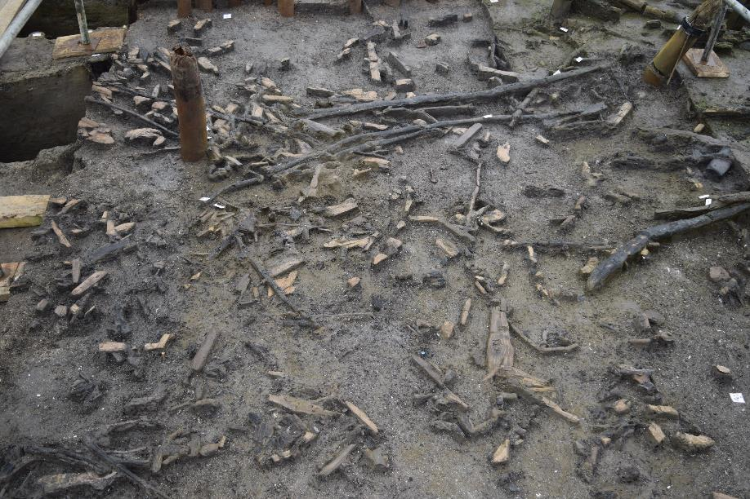

Traces left behind when Must Farm was built
Animal and human footprints
Archaeologists found hundreds of woodchips left behind when people used axes to shape the wood used to build the village. As the river was shallow and slow in the summer, the woodchips didn’t get washed away.
They also found Bronze Age human and animal footprints that had been preserved in the soft mud around the edges of the river.
Woodchips

Slide 12
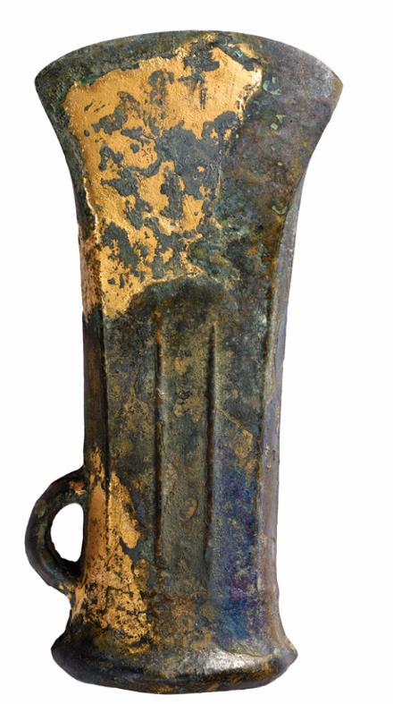
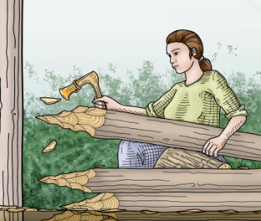
What tools did people use to build Must Farm?
The main material for building the houses at Must Farm was wood. People would have needed lots of tools to chop and carve the wood into the right shapes and sizes.
During the Bronze Age flint was used a lot less and people made most of their tools from a metal called Bronze instead.
At Must Farm flint tools did not play an important role in building the houses.
Earlier in prehistory people made their tools from stone. These were usually made from flint, a stone that could be shaped to have very sharp edges.

Slide 13
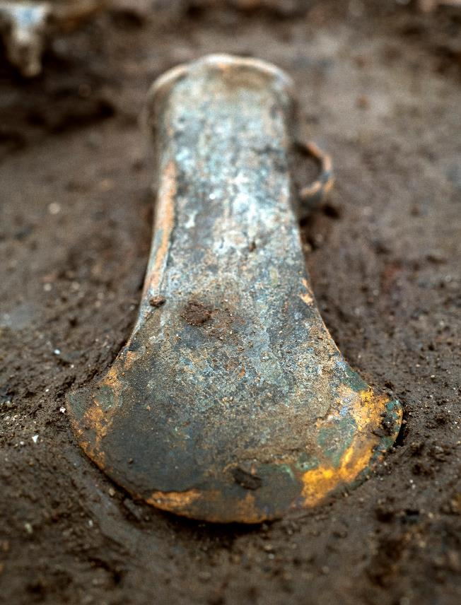
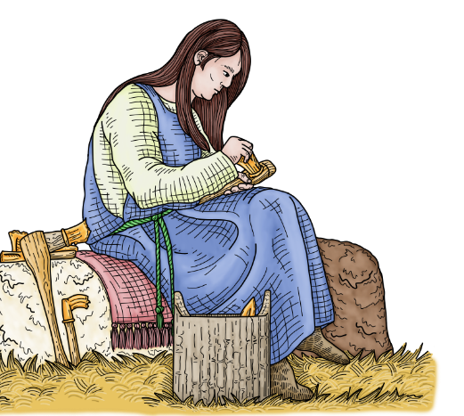
What is Bronze?
Bronze is a special metal called an alloy that is made by mixing copper and tin together. Combining two different metals together creates a harder metal that is much better for making tools.
Copper and tin were dug out of the ground at mines. The UK had Bronze Age mines in Wales and Cornwall and the metal would have been traded across the country for people to use.
The bronze tools found at Must Farm were probably made by melting down old or broken objects. They were an early example of recycling!

Slide 14
What tools were found at Must Farm?
Archaeologists were very lucky to find lots of different tools that were used at Must Farm.
Sickle
Gouge
Socketed Axe
Chisel
Faceted Axe

Slide 15
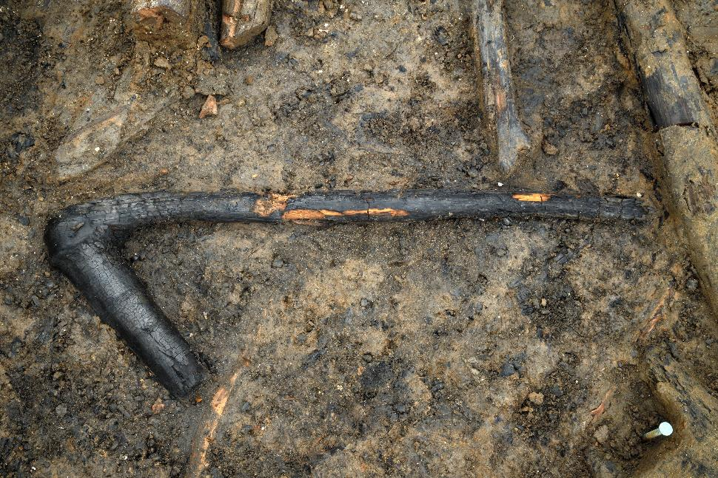
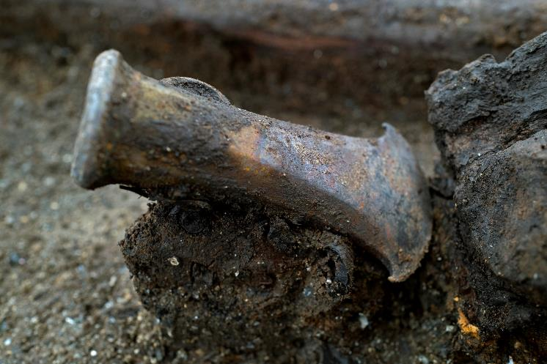
Axes in the Bronze Age
Axe haft
Axes would have been one important tool for people in the Bronze Age. Axes are made of the wooden handle, called a haft, and the axehead, the sharp metal piece which does the cutting.
There are different sizes of axes and their handles which could have been used for different jobs. Larger and heavier axes could have been used to chop down trees while smaller and lighter axes were for more careful work.
Lighter axehead

Slide 16
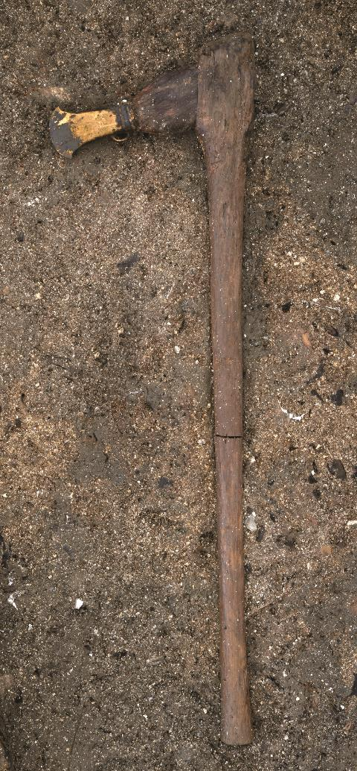
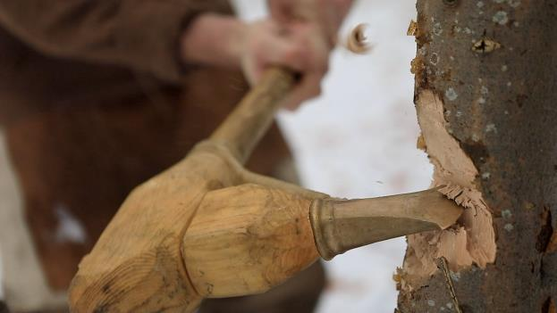
A special axe from Must Farm
axehead
One of the axes found at Must Farm still had all its wood preserved, which is very rare. It was also made in a very special way that meant people could easily swap the axehead with a different one.
Only two axes made in this way have been discovered from the Bronze Age from the UK!
haft

Slide 17
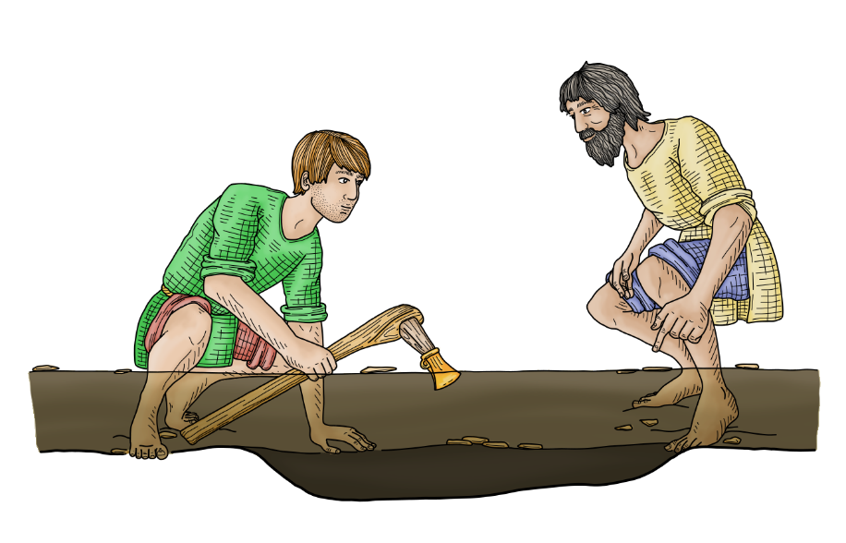
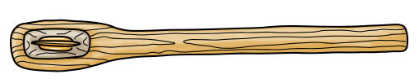
Placing an axe in the river at Must Farm
From looking at the layer the axe was from, archaeologists knew it had been carefully placed in the river underneath the house.
When archaeologists can see that people in the past specially placed artefacts they call it deliberate deposition.
The axe wasn’t broken and could still have been used. So, why did the people at Must Farm deposit it under a house?
  To bring good luck to the house?
  As an offering to a god that people believed in?
  To mark finishing building the house?
We will never know but why do you think the people at Must Farm left the axe in the river?

Slide 18
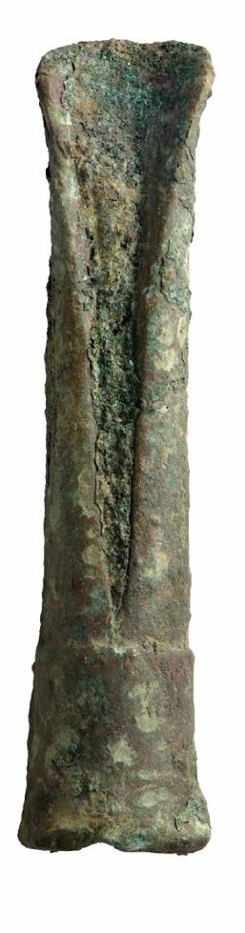
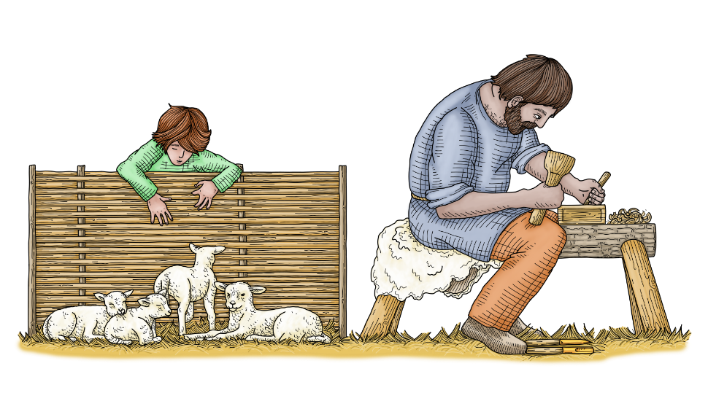
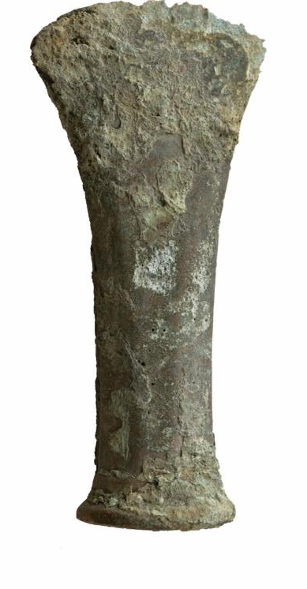
Gouges and chisels
The builders at Must Farm would have used other smaller tools like gouges and chisels.
Gouges and chisels would have been used to carve wood and could be used to make artefacts or the holes for joints, which would have held pieces of wood together.
Chisel
Gouge

