Slide 1

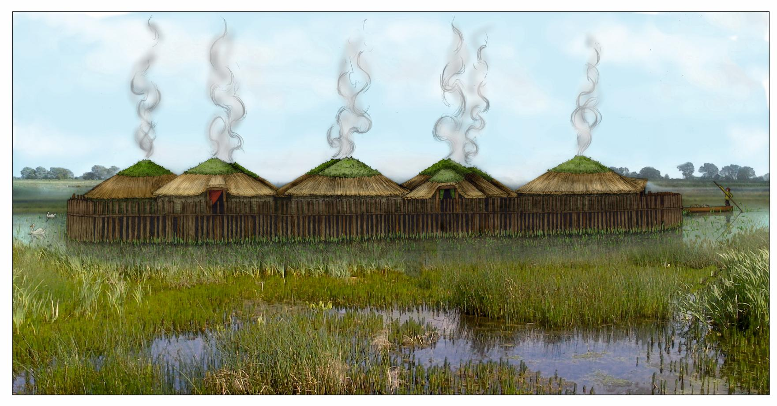
Introducing the Must Farm Village

Slide 2
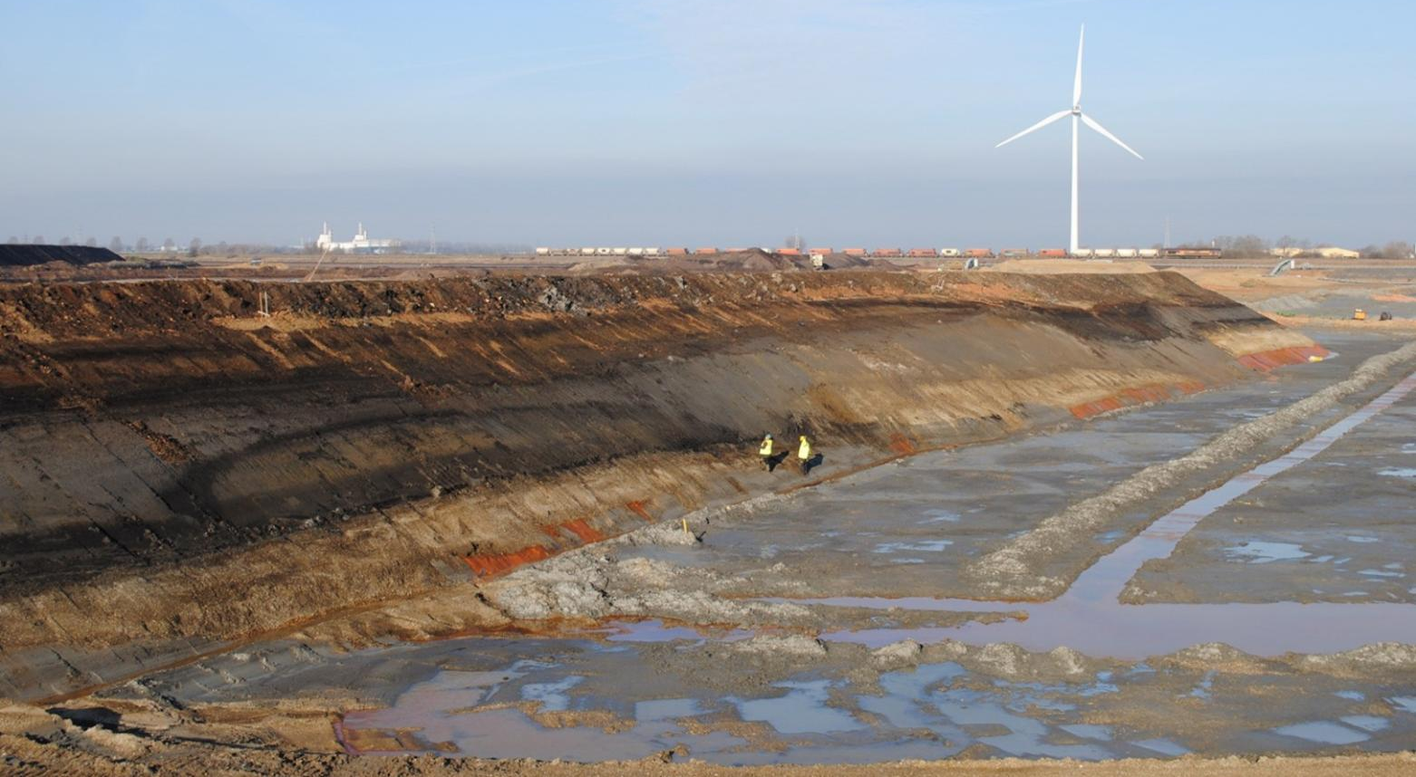
Finding Must Farm
In 1999 an archaeologist was walking along the edge of a quarry in Whittlesey, near Peterborough when he saw some interesting wooden posts sticking out of the ground.
The posts were studied carefully and were found to be almost 3,000 years old, from a period called the Late Bronze Age.
This discovery was very exciting and archaeologists wanted to know whether more finds were buried under the ground.
A least 11 types of wood were used to build Must Farm

Slide 3
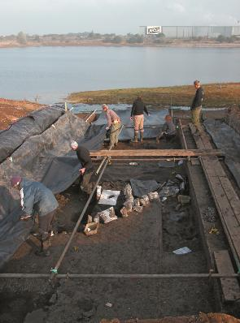
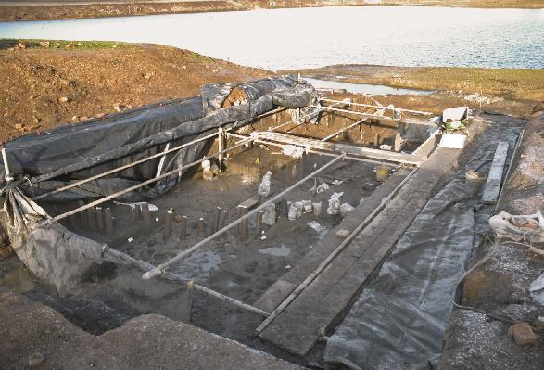
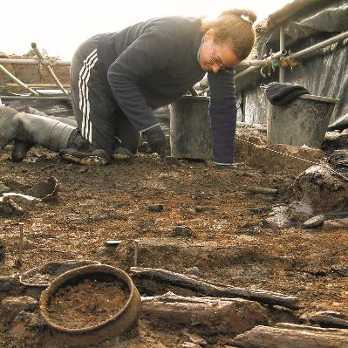
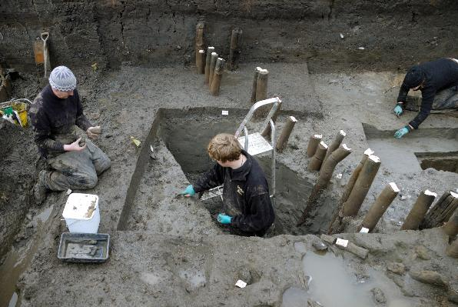

Evaluating the Archaeology
When archaeology is first found a small dig is usually carried out that is called an evaluation
Evaluations involve digging some holes into the ground to get a better idea of what archaeology might be there
At Must Farm the evaluation showed that there was lots more archaeology but a bigger dig would be needed to understand it
By doing an evaluation archaeologists can find out:
  How much archaeology there is
  How far it might go beneath the ground
  How well preserved any artefacts are

Slide 4
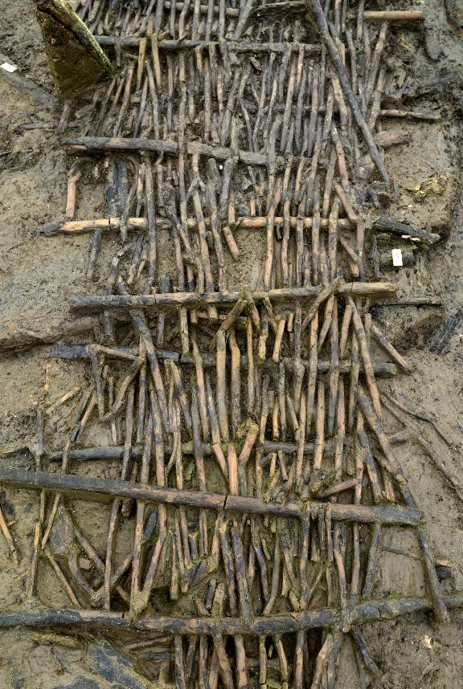
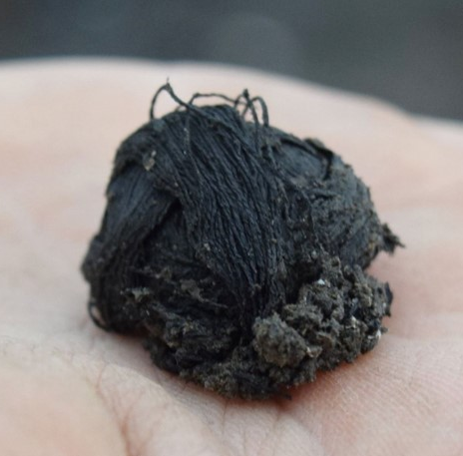
Preservation at Must Farm
Organic materials, that come from living things like wood, food or cloth, will usually rot away in the ground over time.
A ball of fibre
Sometimes special conditions in the ground can preserve organic finds and stop them from rotting and disappearing. This can happen if the ground is very wet or very dry.
At Must Farm the soil around the artefacts was waterlogged (very wet). This meant archaeologists found lots of very rare and important objects.
A wattle walkway

Slide 5
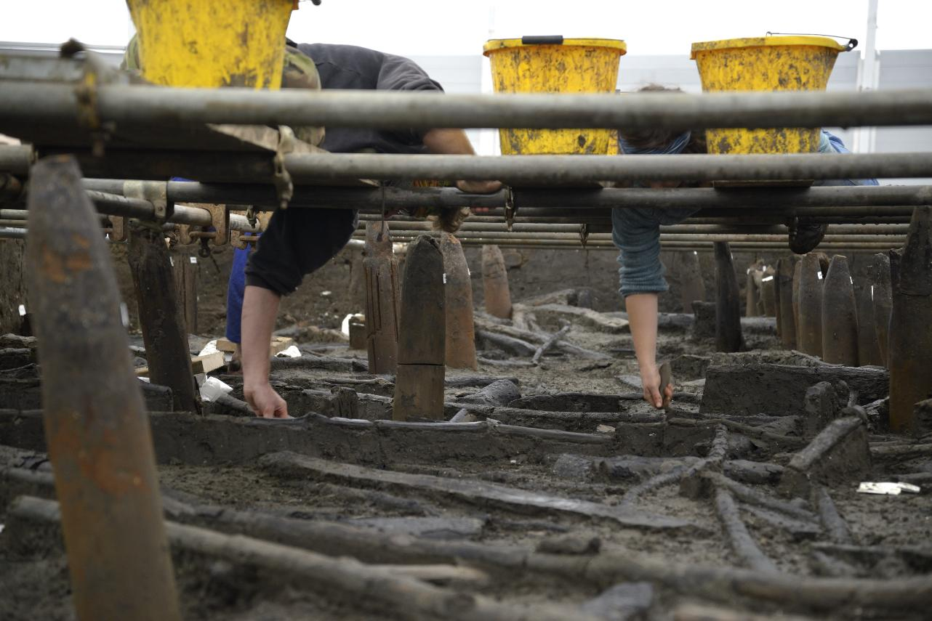
Digging Must Farm
There were so many amazing artefacts and pieces of wood at Must Farm that archaeologists had to be very careful when digging.
Walking on the ground could have damaged the fragile finds so the dig team made special platforms to move around and work from.
They had to lean down and steadily remove the soil around the archaeology until it was safe to walk on.

Slide 6
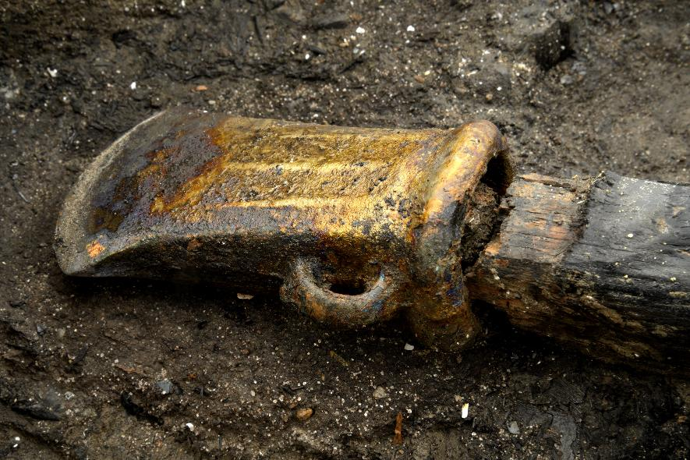
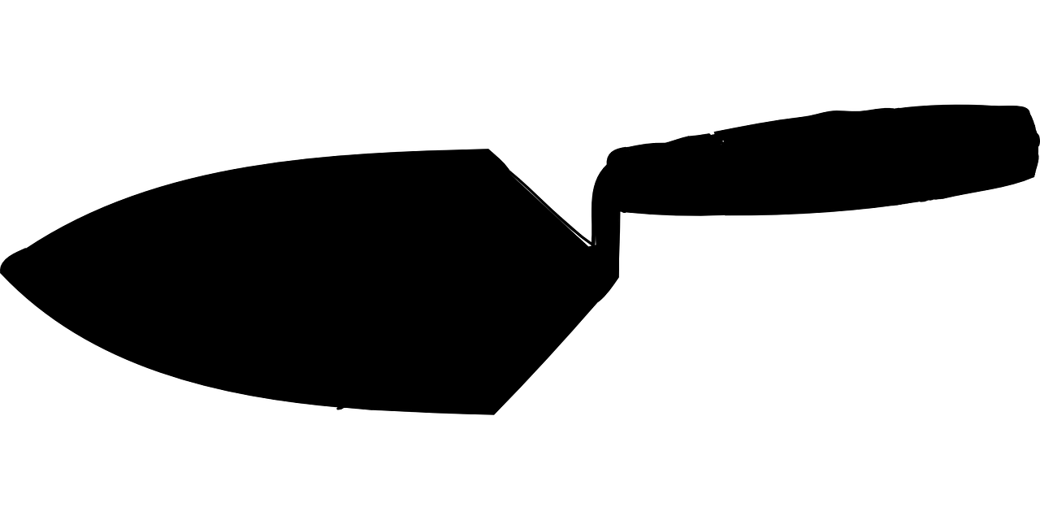
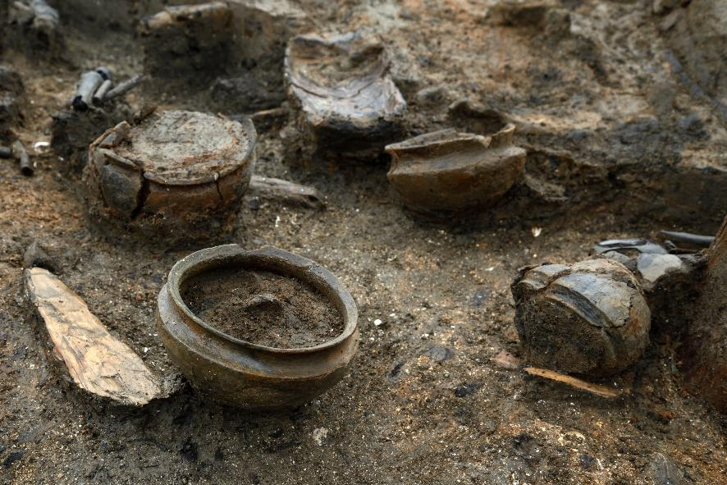
What did Archaeologists find at Must Farm?
Archaeologists found lots of Late Bronze Age wood and artefacts like pots, tools, weapons and jewellery.
This material told them they had discovered the remains of a village where people had lived in 850 BC. That’s almost 3,000 years ago!

Slide 7
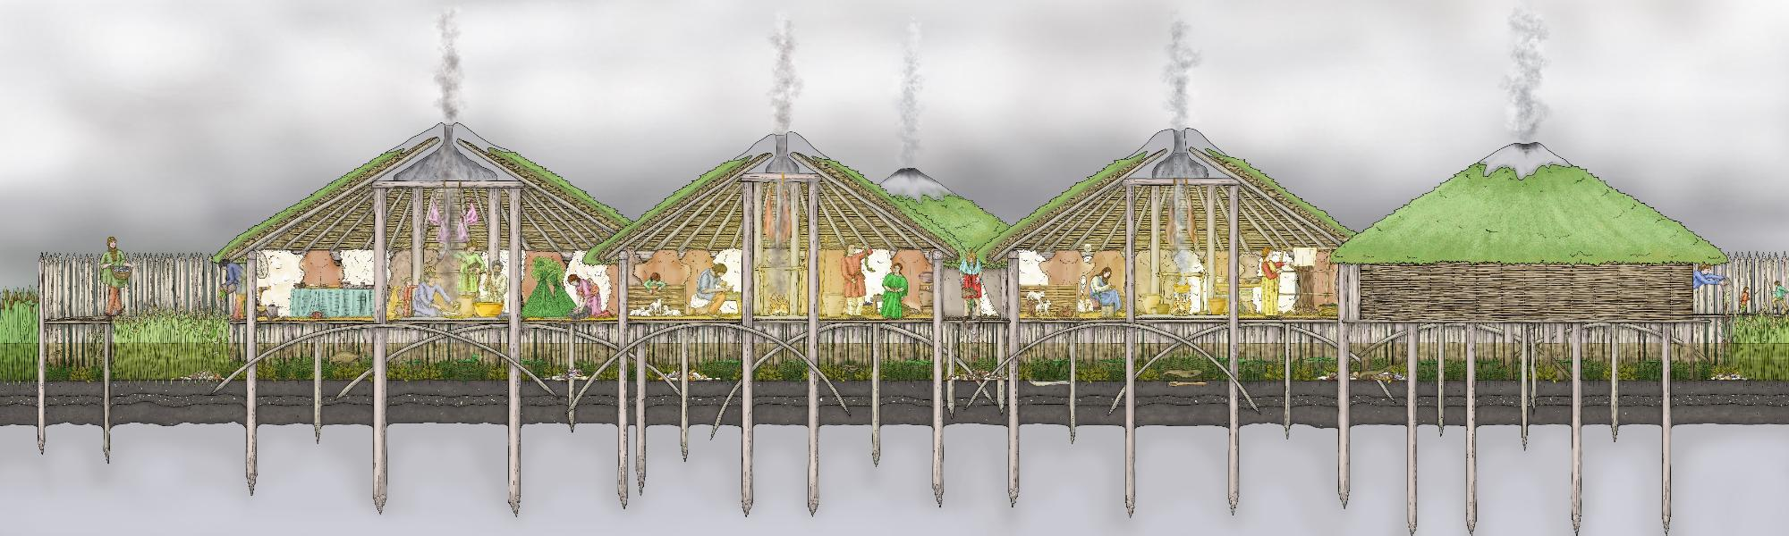
What would the Must Farm Village have been like?
The village at Must Farm was very special as its houses would have been built on stilts above a river.
Around the outside of the village was a big fence of sharp stakes called a palisade.

Slide 8
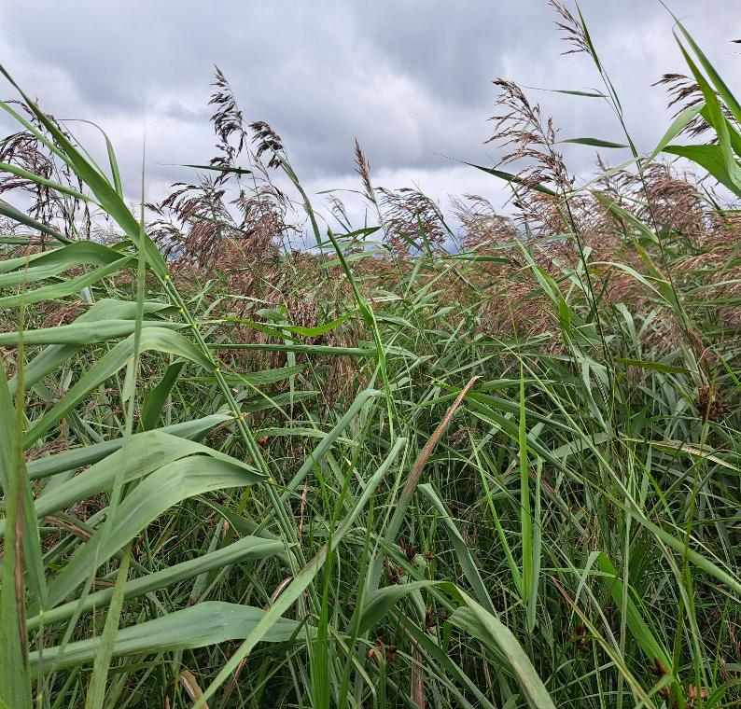
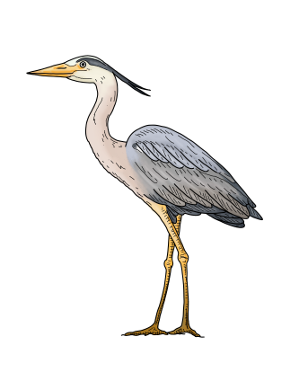
Where was Must Farm Built?
Must Farm was built in an area called The Fens which is in eastern England.
The Fens
This was a very wet and marshy place in the Bronze Age but would have had lots of different animal and plants living there.
These different species would have been important for food and as resources to make things.
Building a village on stilts on a river would have protected people against flooding and made it easy to move around on boats.

Slide 9
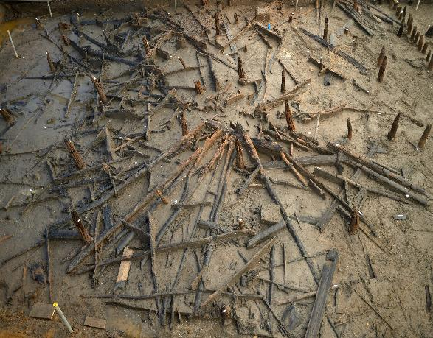
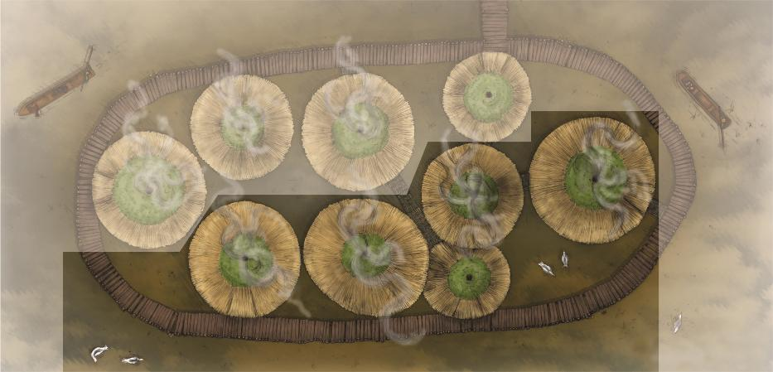
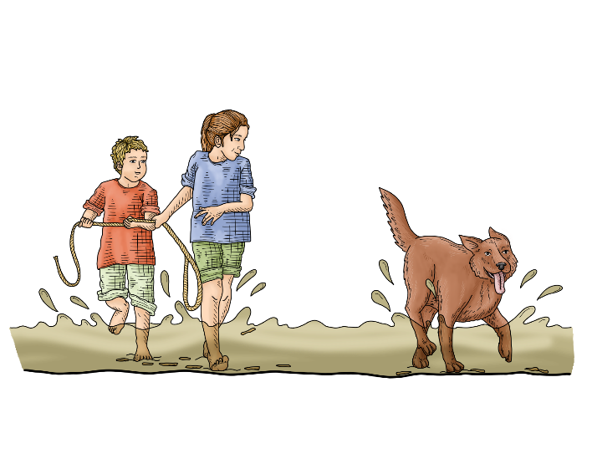
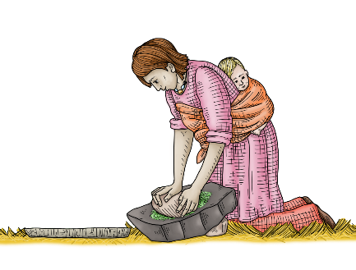
How many people would have lived at Must Farm?
Archaeologists found five houses at Must Farm, which they think would have been half of the village as some was quarried away in the 1960s.
A roundhouse
This meant that there were probably nine or ten houses altogether with a family living inside each.
In total, around 50 people would have lived in the village alongside animals like dogs and sheep.

Slide 10
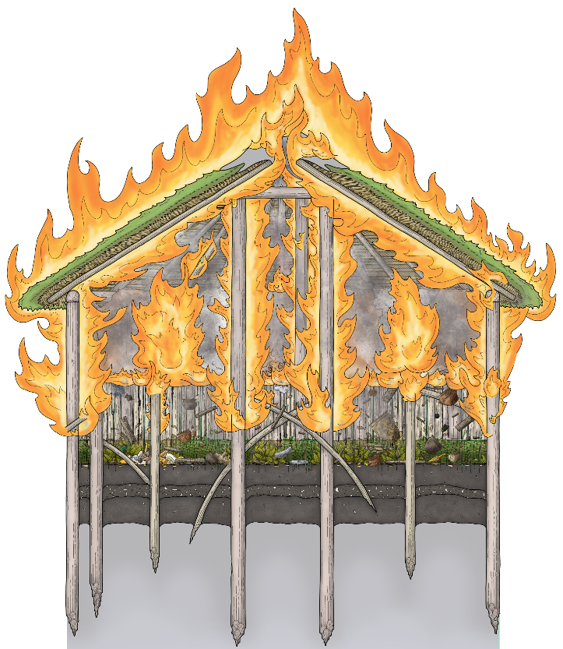
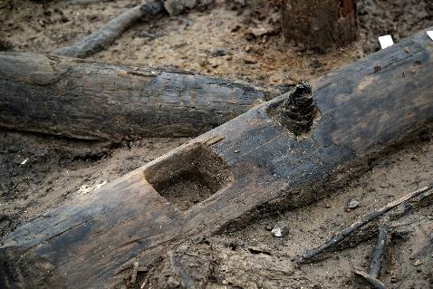
The Must Farm fire
Archaeologists found lots of charcoal and burnt wood, which showed that the village at Must Farm had burnt down in a big fire.
As the houses burnt, they broke apart and lots of the wood and material used to make them fell into the river below. The wet conditions of the river preserved the wood which let archaeologists understand how the houses had been made.
The fire also meant all the objects from inside the houses fell into the water so archaeologists could understand the different artefacts people kept and used.

Slide 11

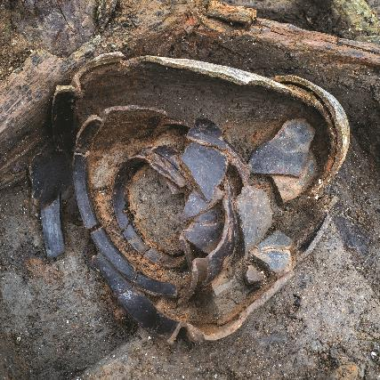
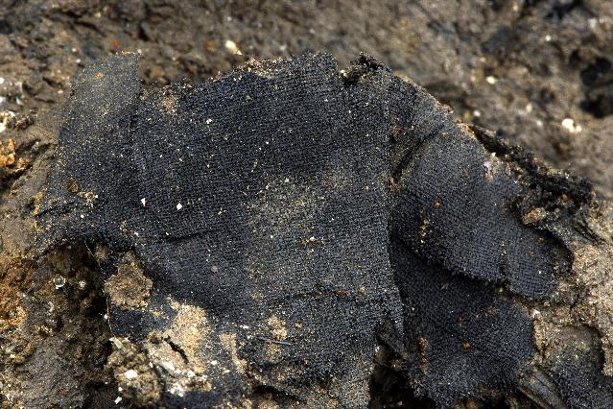
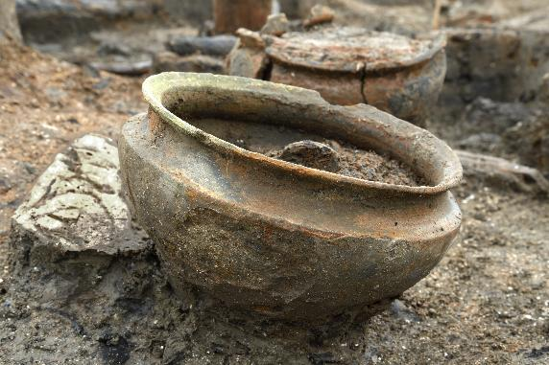
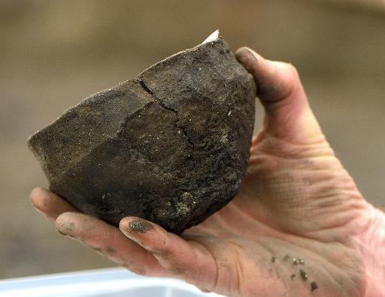
Why is Must Farm important?
The Must Farm village is the best-preserved Late Bronze Age site that’s been discovered in the UK.
The site gives archaeologists lots of amazing information into the daily lives of people living in 850 BC as they can study their homes and the items they had.
Some of the exciting things they’ve been learning:
  What meals people ate by studying preserved bowls of food
  How was a Bronze Age house organised? Where did people sleep?
  How many tools and weapons did people have in the Bronze Age?
  Learning about their health by looking into their poo!

